Slide 1

Dale Last
Shadow Minister for Police & Corrective Services

Slide 2
Youth Justice in 2021…
“I know that there are good people working there, but the system is broken.”
Sue Withers
Inquiry into the Youth Justice and Other Legislation Amendment Bill 2021
Townsville Hearing, 18th March 2021

Slide 3
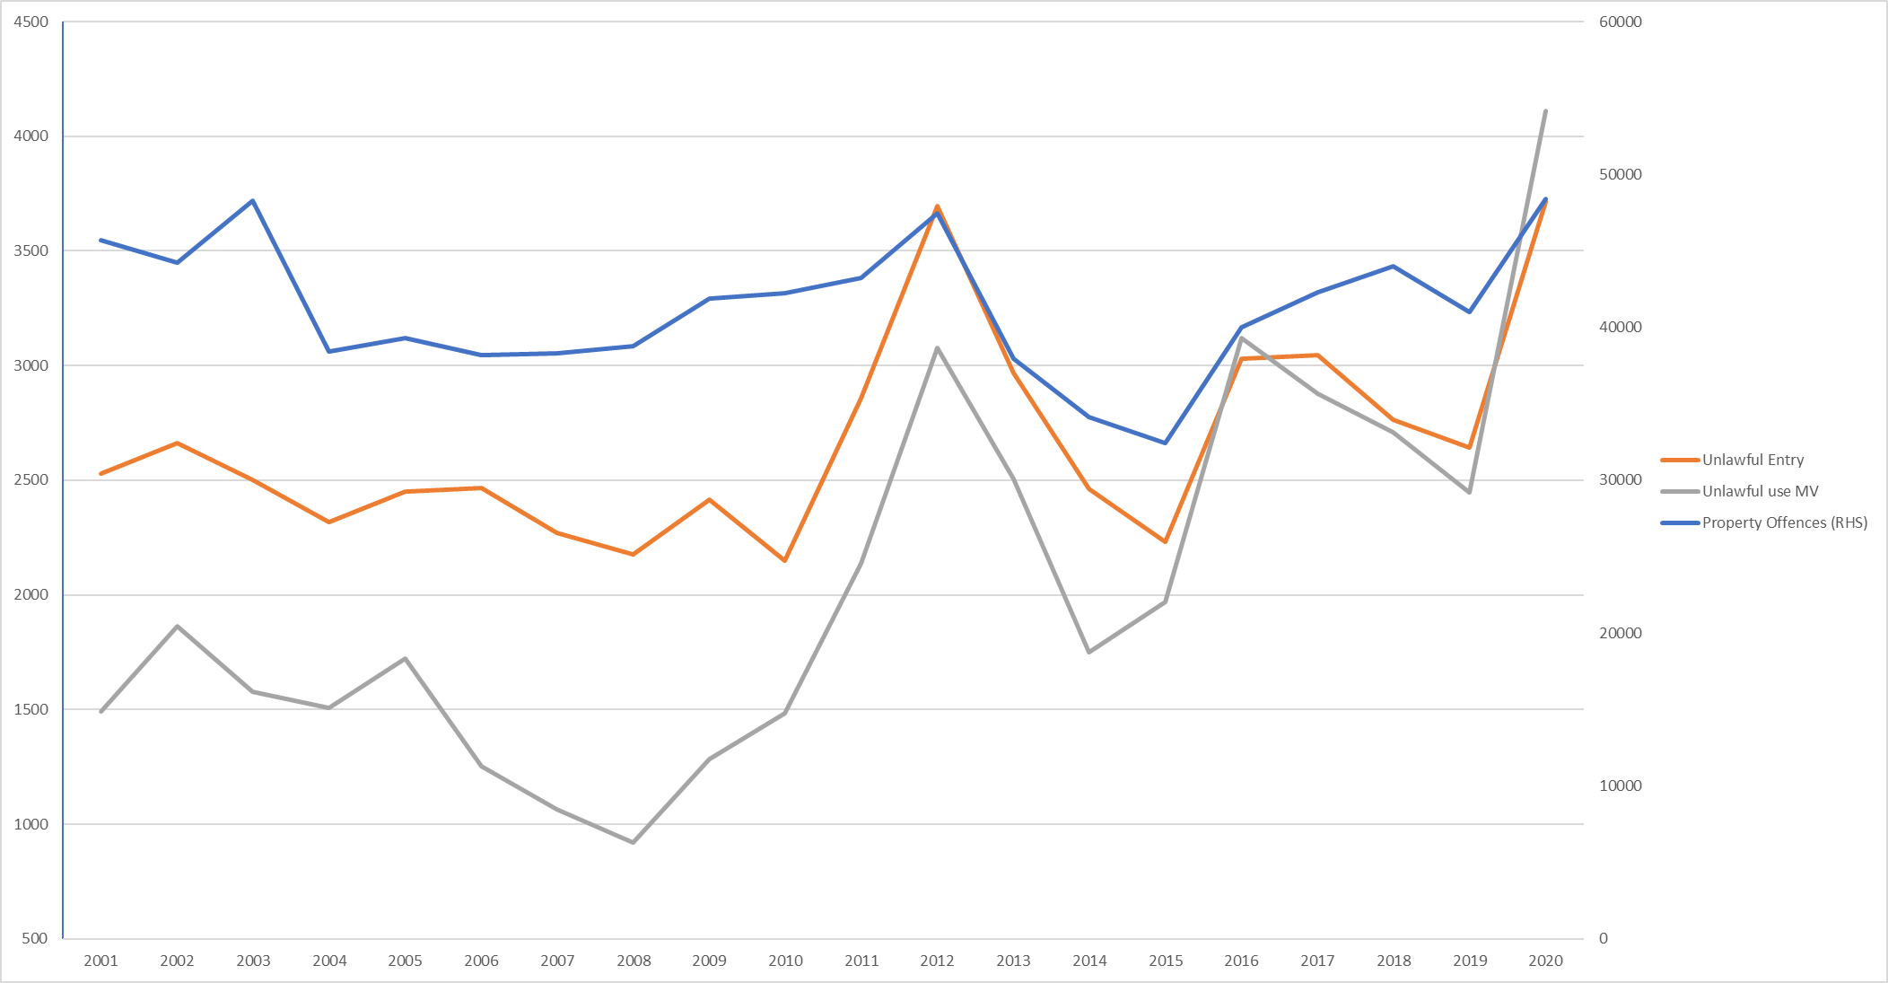
Where are we now?
Number of Juvenile Offenders – Brisbane, Cairns, Gold Coast, Ipswich, Logan, Sunshine Coast & Townsville
Source: www.police.qld.gov.au/maps-and-statistics “LGA Reported offenders number”

Slide 4
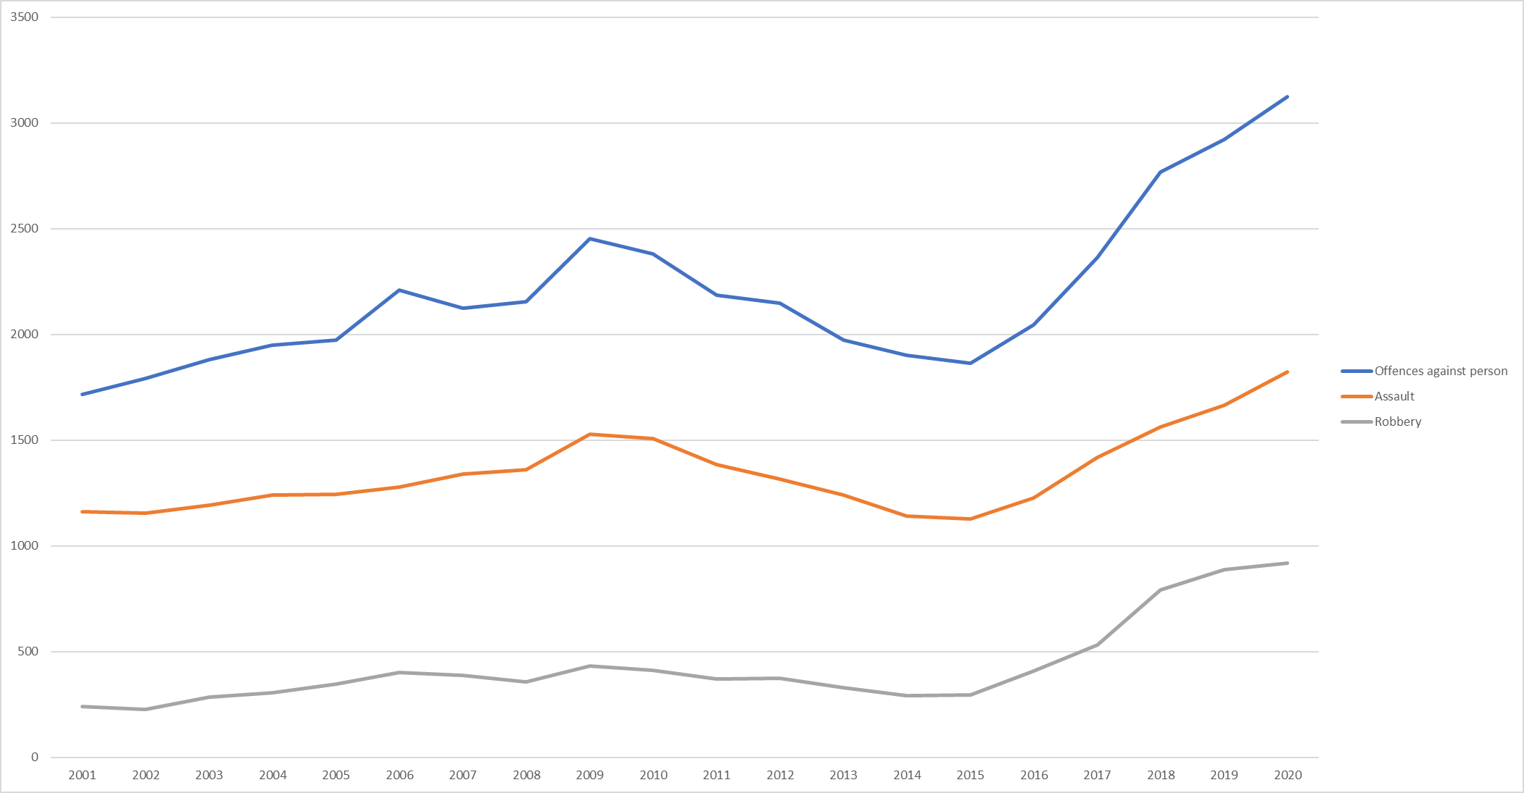
Where are we now?
Number of Juvenile Offenders – Brisbane, Cairns, Gold Coast, Ipswich, Logan, Sunshine Coast & Townsville
Source: www.police.qld.gov.au/maps-and-statistics “LGA Reported offenders number”

Slide 5
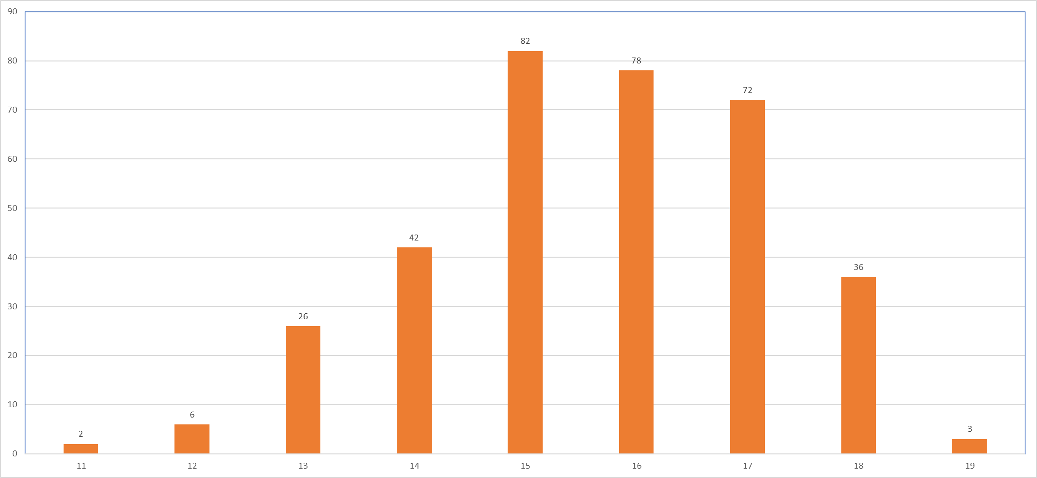
Who are they?
Age of “Recidivist Youth Offenders” as at 31 December, 2020
Source: https://www.parliament.qld.gov.au/documents/tableOffice/questionsAnswers/2021/4-2021.pdf
Note: Offences are counted based on the date they are proven in court, not by the date the offence occurred.

Slide 6

Let’s think outside the box

Slide 7
Early intervention

Slide 8
Supervision and rehabilitation

Slide 9
Questions?

